Slide 1
Causal Inference

Slide 2
Ideally…
To assess causality, we’d ideally set up a randomized controlled trial
Entities are randomly sorted into treatment and control groups
The treatment group is subjected to some type of policy, treatment, intervention, drug, etc. while the control group is not (Though the control group may be given some type of placebo)
After enough time has passed for the treatment to take place, the outcomes / changes in each group are measured
The difference in outcomes is the effect of the intervention
Randomizing group assignment is the key to determining if X caused Y, but it’s often impossible outside of a clinical setting

Slide 3
Difference In Differences (DiD)
Causal effects are determined by comparing the changes in outcomes over time between a treatment group and a control group
Assumes that, absent treatment, the differences in the groups would have stayed the same
DiD = (Post-Treatment Treatment Group Outcome - Pre-Treatment Treatment Group Outcome) - (Post-Treatment Control Group Outcome - Pre-Treatment Control Group Outcome)
Yit = B0 + B1(Period Dummy) + B2(Group Dummy) + B3(Period and Group Interaction) + Eit
B3 is the difference in differences

Slide 4
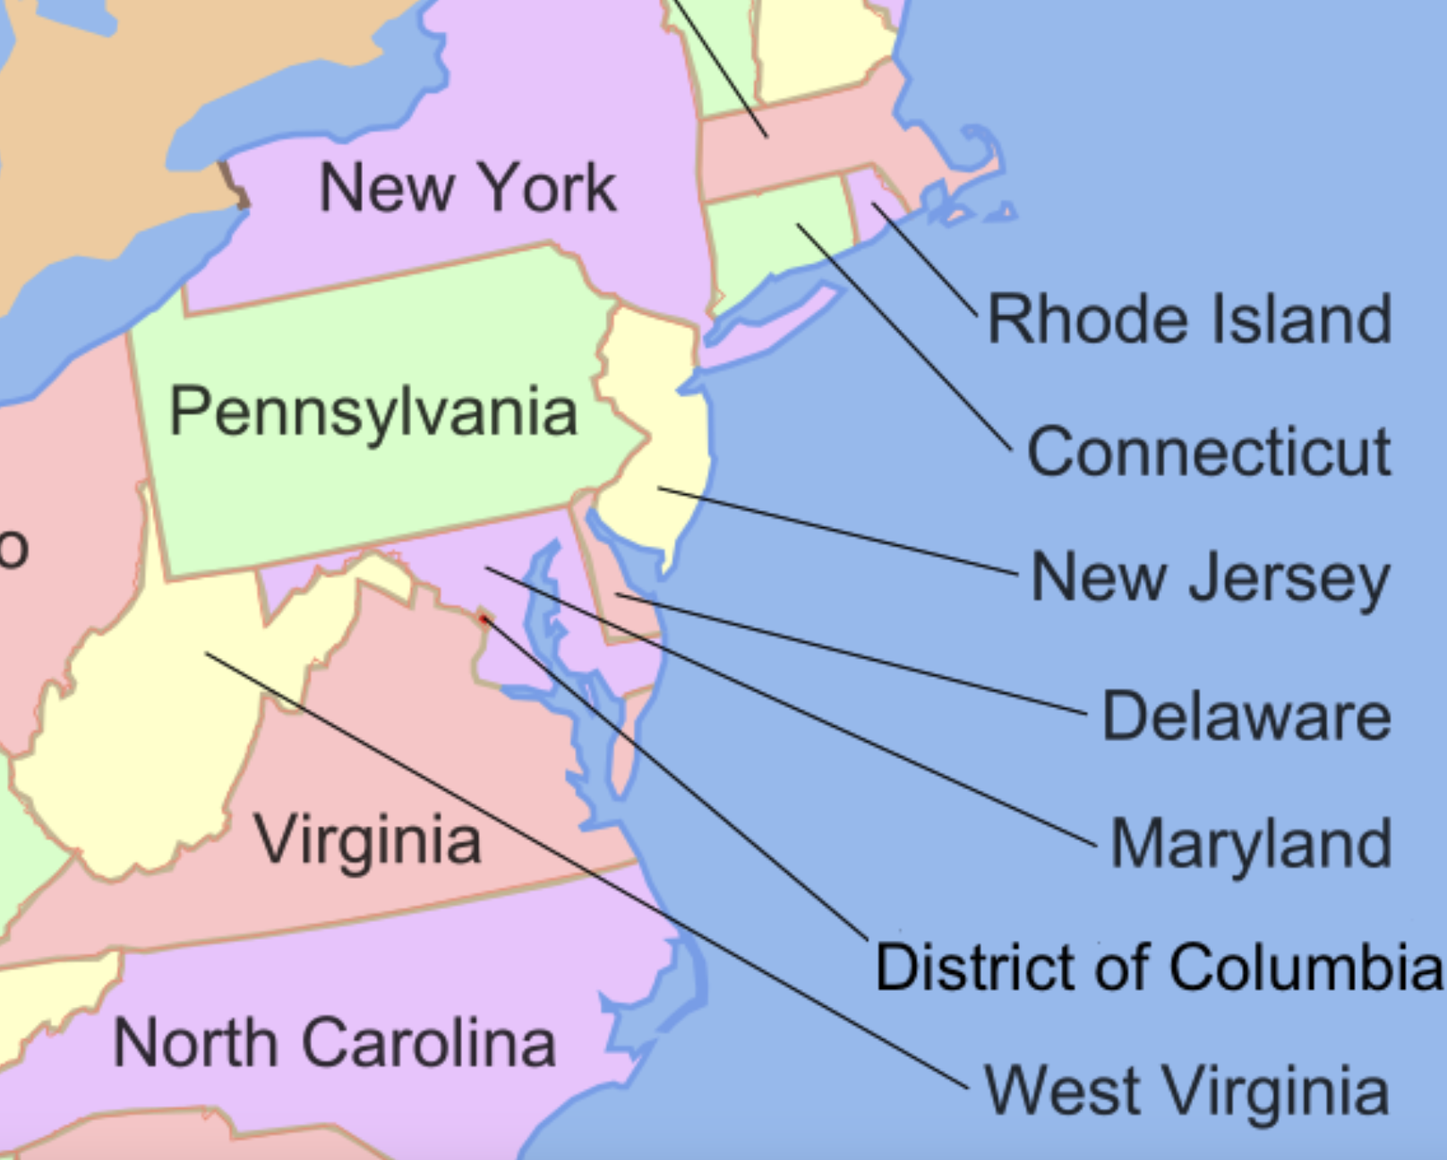
Card & Kruger
New Jersey and Pennsylvania share a border, and thus a fairly homogeneous population
NJ raised the minimum wage from $4.25/hr to $5.05/hr, while PA kept its minimum wage at $4.25/hr
Economic theory suggests that the quantity of labor demanded will fall if the price of labor rises

Slide 5
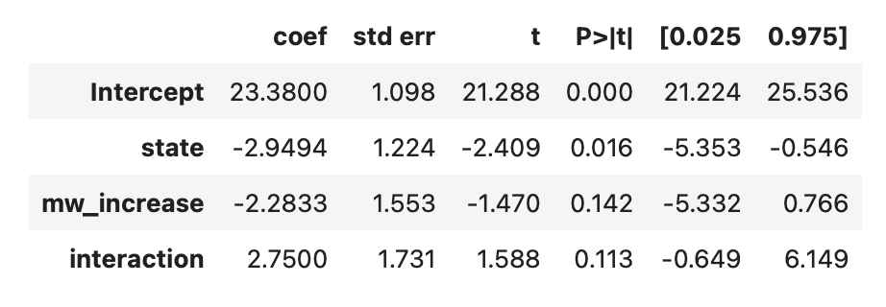
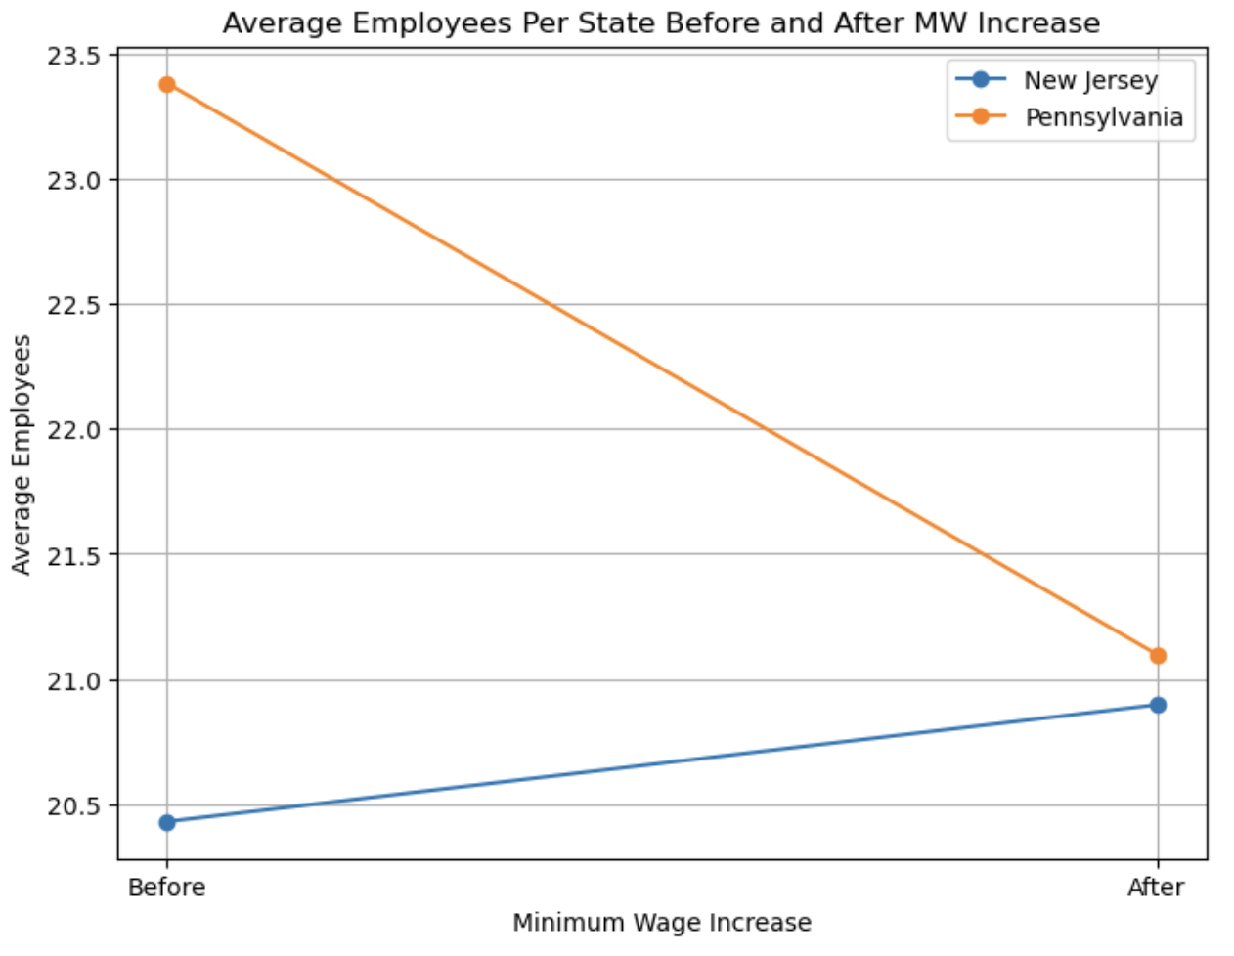
DiD Regression
Employment = B0 +
B1(State Dummy) +
B2(Period Dummy) +
B3(State * Period) +
Bi(Other Variables) + E
B3 = Treatment Effect = Higher Employment Post MW Increase

Slide 6
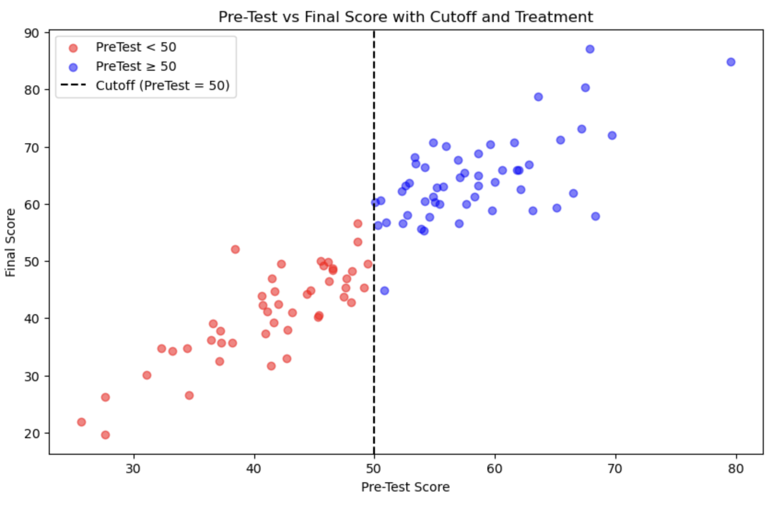
Regression Discontinuity Design
Causal effects are determined by comparing outcomes between treatment and control groups when assignment is determined by a cutoff point / threshold
Assumes groups on either side of the cutoff are likely to be very similar
Consider a group of students who get to take honors classes if they fell above a certain score (50%)

Slide 7
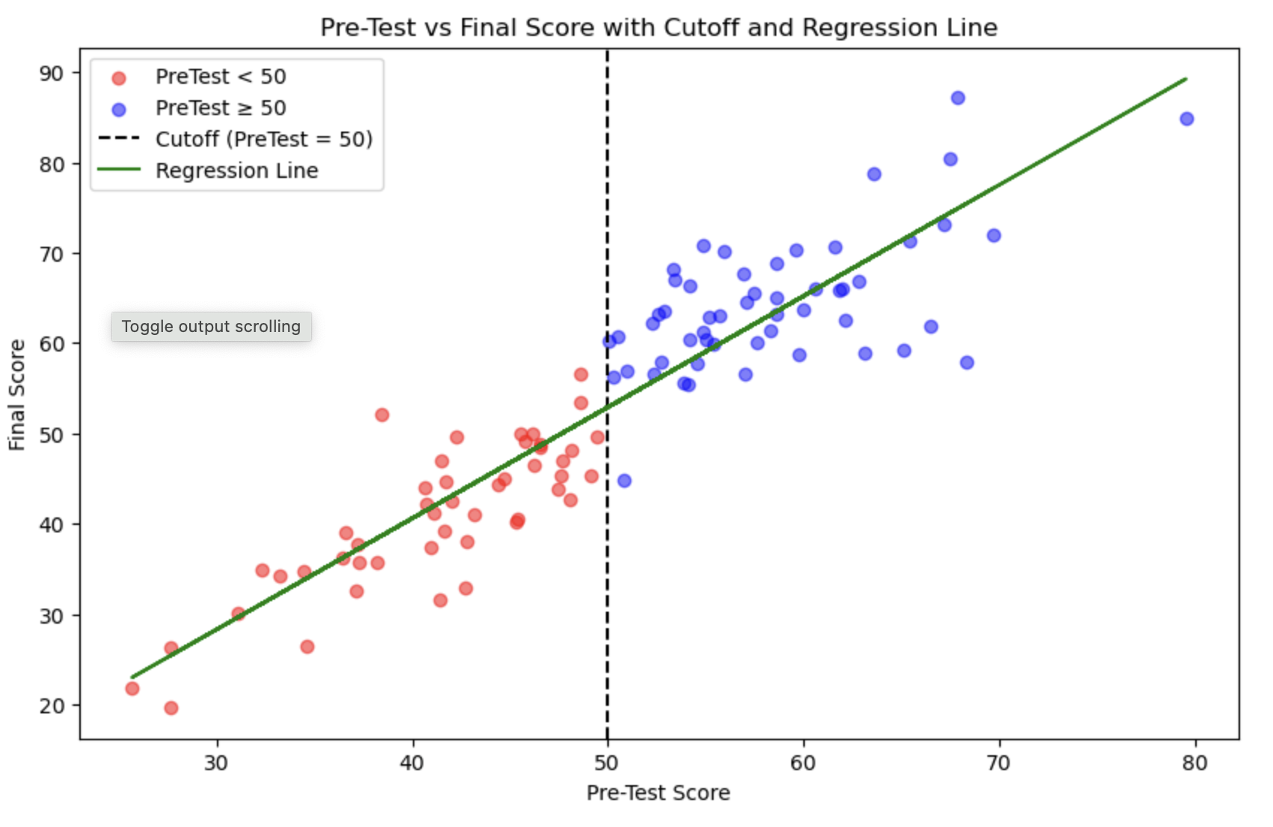

Slide 8
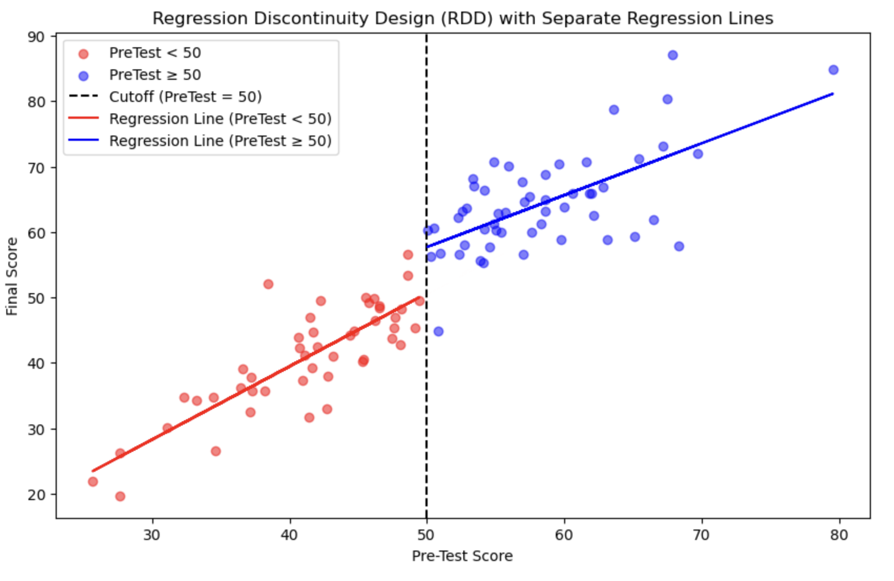
RDD Regression
The causal effect of the treatment (extra education) is measured as the difference in the heights of the regression lines at the cut off
Y =
B0 +
B1*(Treatment Dummy) +
B2*(Running Variable - Cutoff) +
B3*D*(Running Variable - Cutoff) +
E
B0 = Expected outcome just above the cutoff
B1 = Treatment effect at the cutoff
B2 = Slope of the outcome variable for the control group
B3 = The difference in slopes between the treated and control groups

Slide 9
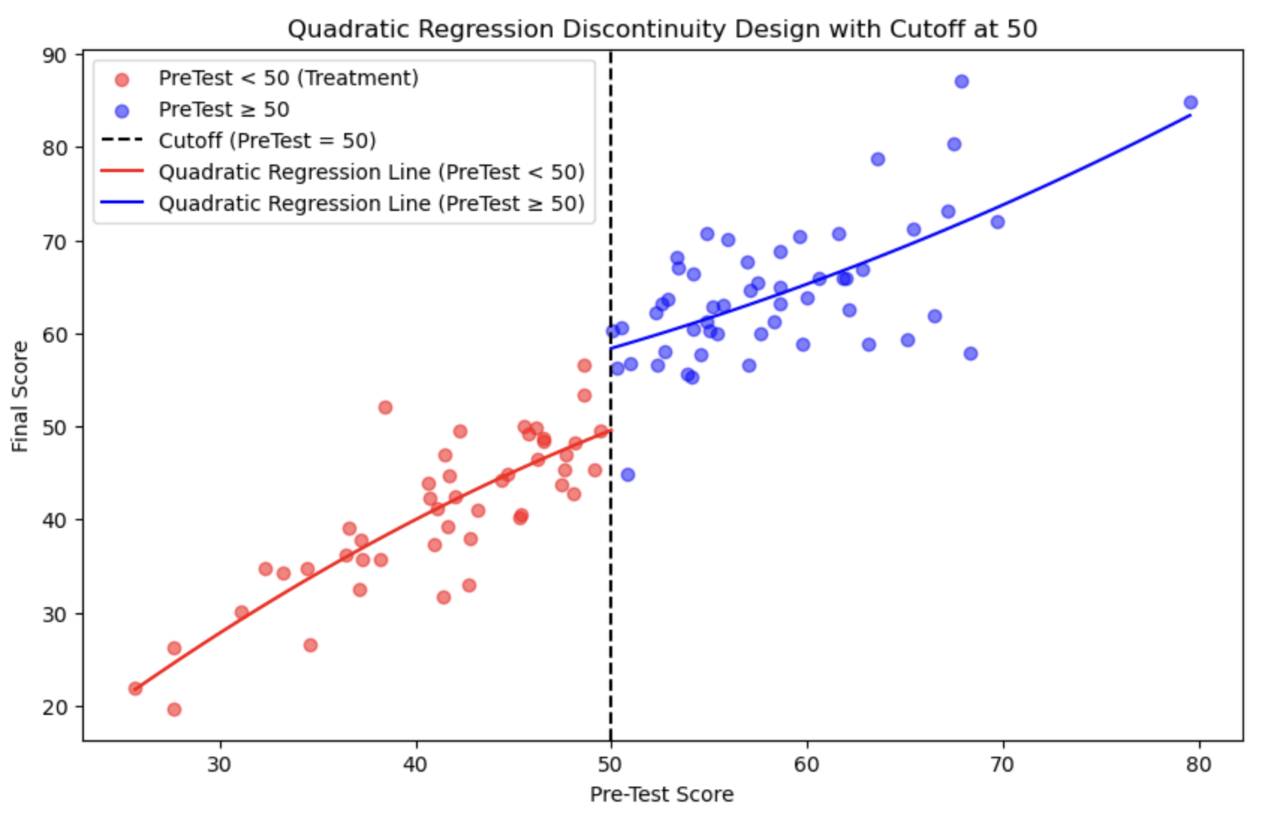
Quadratic RDD

Slide 10
Two Stage Least Squares
Does education cause higher wages, or do smart and ambitious people go to college and are incidentally likely to earn higher wages regardless of education?
Wage = B0 + B1(Education) + E
Omitted variable bias likely since no controls for ability, upbringing, etc.
Use an instrumental variable:
A) One that is strongly correlated with endogenous variable (education)
B) Not correlated with the outcome variable (wage)

Slide 11
2SLS Continued
Step 1: Regress the endogenous variable on the instrument and obtain fitted values (y-hat OR education-hat)
Education = B0 + B1*Proximity to College + E
Step 2: Regress the original dependent variable on the fitted values from the first equation.
Wage = B0 + B1*Education-Hat + E
Education hat is no longer correlated with ability and upbringing, so now B1 reflects the causal effect of education on wages

Slide 12
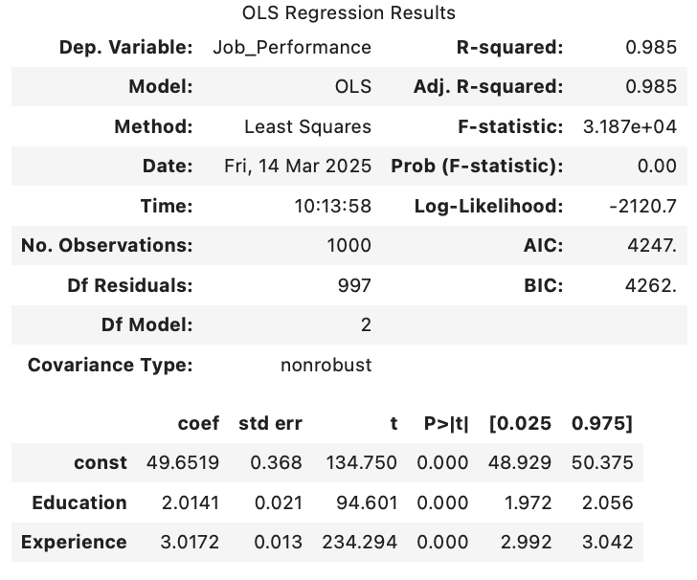
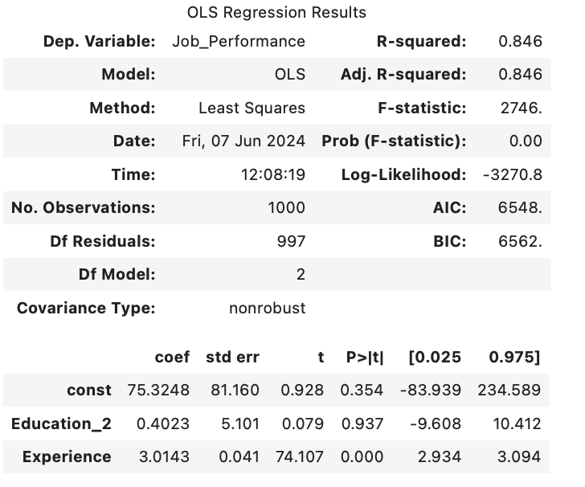
OLS vs 2SLS
OLS overstated the impact of education, 2.0141 vs 0.4023

